Slide 1
Session
With Spring security

Slide 2
HTTP is a stateless protocol
HTTP is a "stateless" protocol which means each time a client retrieves a Webpage, the client opens a separate connection to the Web server and the server automatically does not keep any record of previous client request.
https://www.tutorialspoint.com/as-http-is-a-stateless-then-how-to-maintain-the-session-between-web-browser-and-web-server
http://home.sandiego.edu/~liao/cs194/1998.client.server/lectures/maintain.state.html

Slide 3
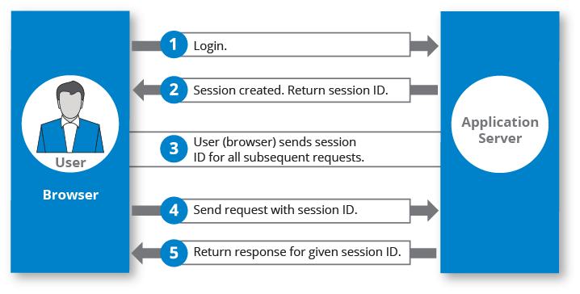
How to make it Stateful?--Session
https://hazelcast.com/glossary/web-session/

Slide 4
Session management
Session management can be achieved in one of the following ways
Cookies- data sent from a website and saved by the user's web browser on the user's computer as the user browses.
Hidden form field--is a hidden data, which will not be shown to user and can not be modified. However, when the user submits the form, hidden data would be sent.
URL Rewriting--is the method of modifying the URL parameters.
HttpSession--enables data to be associated with individual visitors.
<input type="hidden" name="uname" value="Vimal Jaiswal">
https://www.techgeeknext.com/spring-boot/spring-boot-session-management
https://www.javainuse.com/spring/springboot_session
Notes:
Cookie is a small piece of data that a server sends to the user's web browser. The browser may store it and send it back with later requests to the same server. Typically, it's used to tell if two requests came from the same browser.
https://www.wisecleaner.com/think-tank/292-What-are-Cookie--Session.html

Slide 5


How Do Cookies Work?
Cookies are sent to the client by the server in an HTTP response and are stored in the client (user’s browser).
The server sets the cookie in the HTTP response header named Set-Cookie. A cookie is made of a key /value pair.
Once the browser gets the cookie, it can send the cookie back to the server.
Notes:
https://reflectoring.io/spring-boot-cookies/

Slide 6
How long is a Session?
“Session” is the term used to refer to a visitor’s time browsing a web site. It’s meant to represent the time between a visitor’s first arrival at a page on the site and the time they stop using the site.
Depending on the site, a developer may define a web session as short as five minutes or as long as 1,440 minutes (an entire day).

Slide 7
Spring Security and Sessions
https://www.baeldung.com/spring-security-session

Slide 8
Set session timeout
server.servlet.session.timeout=60
seconds

Slide 9
When session expires
customize it with the following code in the WebSecurityConfig
.and()
.sessionManagement()
.invalidSessionUrl("/login")
//you can customize the url when the session expires
.maximumSessions(1)
.maxSessionsPreventsLogin(true)
.sessionRegistry(sessionRegistry());

Slide 10
Add SessionRegistry to WebSecurityConfig.java
@Bean
public SessionRegistry sessionRegistry() {
SessionRegistry sessionRegistry = new SessionRegistryImpl();
return sessionRegistry;
}

Slide 11
In CustomUserDetails.java, add the following
To compare if the user logged in is the same user
@Override
public boolean equals(Object o) {
if (this == o) return true;
if (o == null || getClass() != o.getClass()) return false;
CustomUserDetails user2 = (CustomUserDetails) o;
return Objects.equals(user.getEmail(), user2.getUsername());
}

Slide 12
In CustomUserDetails.java, add the following
Need to override the hasCode() method too
@Override
public int hashCode() {
return Objects.hash(user.getEmail());
}

Slide 13
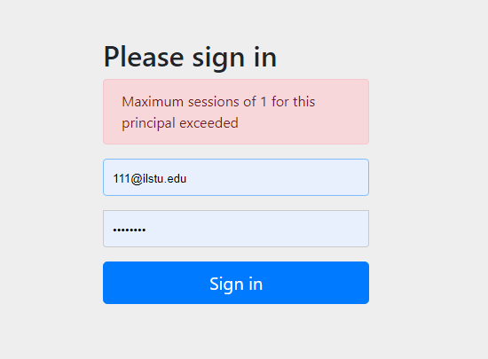
When logged in with two browsers at the same time

